Slide 1
Osceola Business Academy
Imagine if…

Slide 3
State of the Art Facility

Slide 4
Bridging the Gap between entrepreneurial theory and practice
Immersive Learning
Real World Experience
Essential Skill Building

Slide 5
Entrepreneurship Course Progression
Principles of Entrepreneurship
Roles
Ethics
Business Mgmt. and Law
Human relations
Incubator
Marketing and finance
Business Ownership
Law concepts
Operation
Accelerator

Slide 6
Career and Technology Program Connections
Finance and Accounting
Digital Design and Computer Science
Promotional Marketing

Slide 7
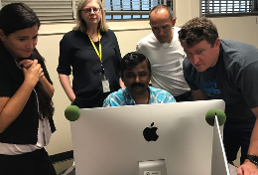
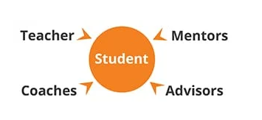
True Partnership between education and business
Coaches
Mentors
Advisors

Slide 8
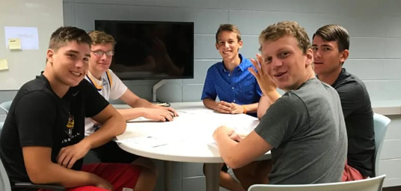
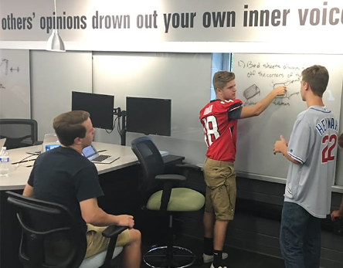
ImAGINE If…
https://www.unchartedlearning.org/community/videos

